Slide 1




Two mode backbone curves for analysis of a rotor-stator contact system
Alexander Shaw¹, Alan Champneys², Michael Friswell¹
¹Swansea University, UK
²University of Bristol, UK
Vibrations In Rotating Machinery 11
University of Manchester, 15th September 2016

Slide 2
Overview
Background
Asynchronous bouncing cycles
Overhung rotor with snubber ring
System definition
Insight into bouncing contact cycles
Internal resonance
Campbell diagram representation
Some simulation results
Backbone analysis
Conclusions and ongoing work

Slide 3
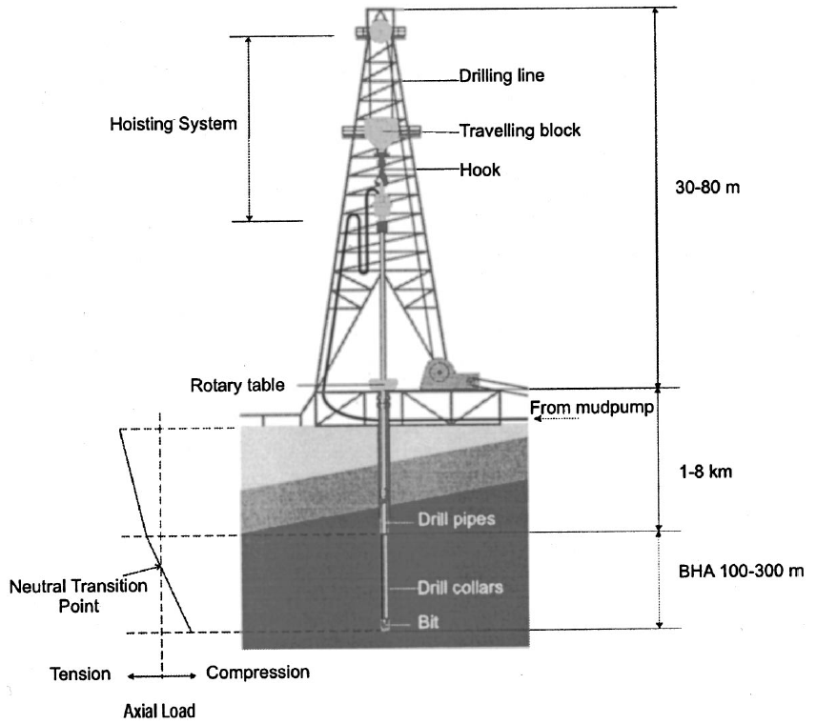
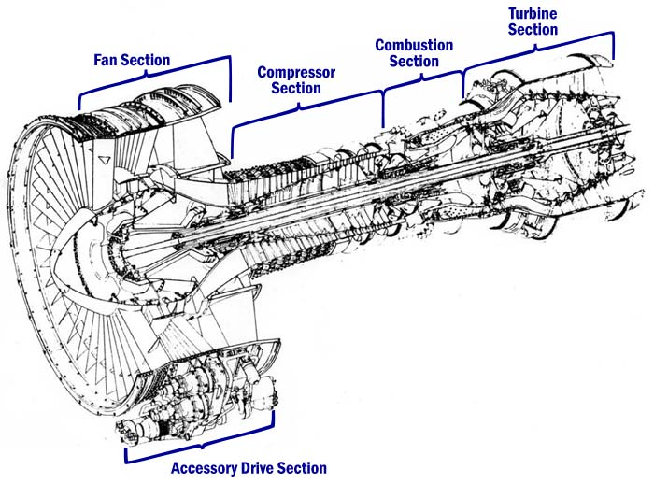
Rotor-stator contact background
Relevant to a huge range of applications from gas turbines to drilling rigs
Magnetic bearing systems also driving interest
R. I. Leine et al., Stick-slip Whirl Interaction in Drillstring Dynamics, J. Vib. Acoust., 2002

Slide 4
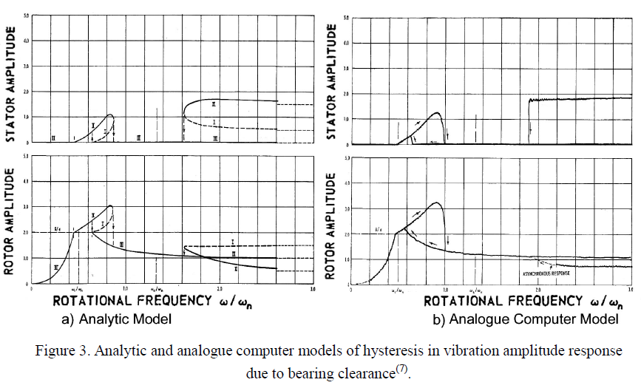
History of rotor-stator contact phenomena: 1960s
“Hula whirl” of stator at supercritical shaft speeds
See also Ehrich’s review paper F. Ehrich, Observations of Nonlinear Phemonena in Rotordynamics, Journal of System Design and Dynamics, Vol 1, No 3, 2008
Ehrich FF, O‘Connor J. 1967 Stator whirl with rotors in bearing clearance. J. Eng. Ind. 89, 381–389. (doi:10.1115/1.3610057)

Slide 5
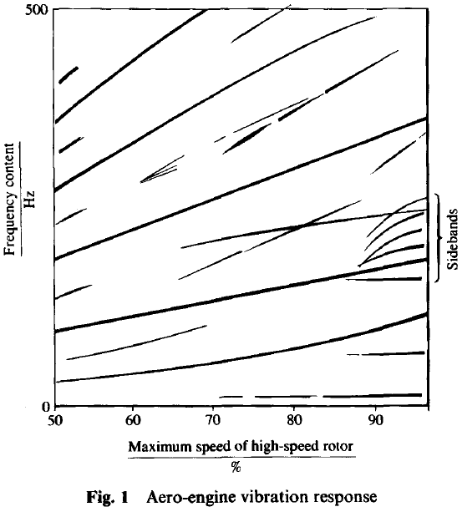
1980s: Asynchronous effects
Neilson and Barr report ‘Sideband’ frequencies in simulated & experimental response of simulated aero engine
Nonlinear stiffness in bearings
Neilson R, Barr A. 1988 Dynamics of a rigid rotor mounted on discontinuously non-linear
elastic supports. Proc. Inst. Mech. Eng. C J. Mech. Eng. Sci. 202, 369–376. (doi:10.1243/PIME_
PROC_1988_202_135_02)

Slide 6
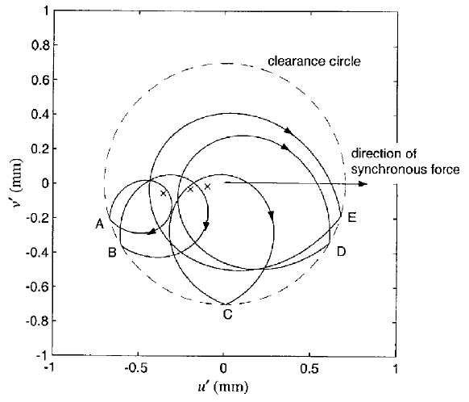
2000s:
Many more bifurcation and experimental studies (e.g. Karpenko, Wiercigroch et. al.)
Cole and Keogh produce analytical work using impact maps instead of smooth functions
They also distinguish synchronous vs. asynchronous orbits and exploit the rotating coordinate frame:
Cole M, Keogh P. 2003 Asynchronous periodic contact modes for rotor vibration within an annular clearance. Proc. Inst. Mech. Eng. C J. Mech. Eng. Sci. 217, 1101–1115.

Slide 7
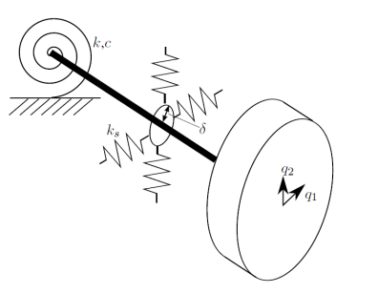
A simple rotor stator contact system
An over hung rotor; a rigid shaft with rotational spring bearing
Snubber ring or rigid contact
Two underlying linear whirl modes: One backward, one forward
The simplest form of the systems we are considering
See: Zilli et. al., Non-linear dynamics of a simplified model of an overhung rotor subjected to intermittent annular rubs, Proceedings of ASME Turbo Expo 2014: Turbine Technical Conference and Exposition, Dusseldorf, 2014

Slide 8
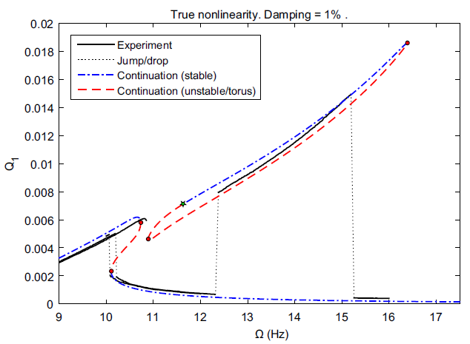
Internal resonance
Nonlinearity ‘couples’ two underlying modes of a structure
Known to cause very rich dynamics in nonrotating systems
Generally a ‘coincidental’ feature in static systems
But potentially ubiquitous in rotating systems – why??
A. D. Shaw, T. L. Hill, S. A. Neild, M. I. Friswell, Periodic responses of a structure with a 3:1 internal resonance, MSSP, 2016

Slide 9
“Traditional” Campbell diagram

Slide 10
Signed Campbell diagram

Slide 11
Rotating system Campbell diagram

Slide 12
Rotating system + harmonics

Slide 13
Simulation/Bifurcation Methodology
Equations of motion simulated in Matlab/ODE45
Events detect when contact threshold is crossed, and activate/deactivate the additional contact forces accordingly
25 random initial conditions at each frequency
Run until steady-state
Maximum and minimum amplitudes then sampled
Gives a “Monte Carlo” bifurcation diagram

Slide 14
Results for soft stator
Stator stiffness same order as effective shaft
Two ‘families’ of bouncing contact
Lower bounds approximately match Campbell diagram prediction for 2:1 and 3:2 resonance

Slide 15
Orbit & FFT Ω=4.3
Rotating frame orbit
2:1 resonance
DC component due to out of balance
Non resonant components are negligible

Slide 16
Orbit & FFT Ω=6.1
3:2 resonance as suggested by Campbell diagram:

Slide 17
Increasing stator stiffness
Contact stiffness ~20 times linear stiffness
Effectively lowering the “damping ratio” for contacting oscillations
Ridiculous numbers of solutions!
(Some cases not adequately settled hence noise)

Slide 18
(some) Orbits for stiffer stator..
Some very interesting resonances
Multi period forms e.g. 6:3 is really a period trebled 2:1 resonance
Real world damping levels probably make these cases academic

Slide 19
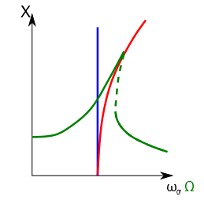
Motivation for backbone curve analysis
Resonant effects imply that the underlying conservative system dynamics are important
Backbone analysis often gives a more general view of the system dynamics than a full analysis at jus one forcing condition
Current ‘Campbell’ based predictions ignore nonlinear effects such as stiffening

Slide 20
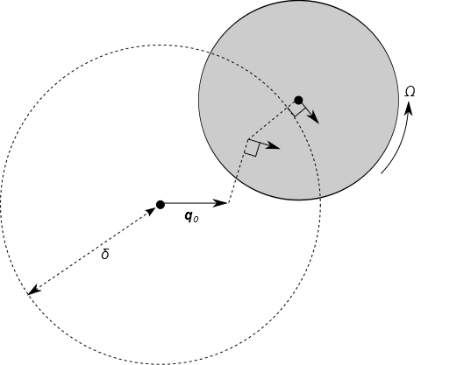
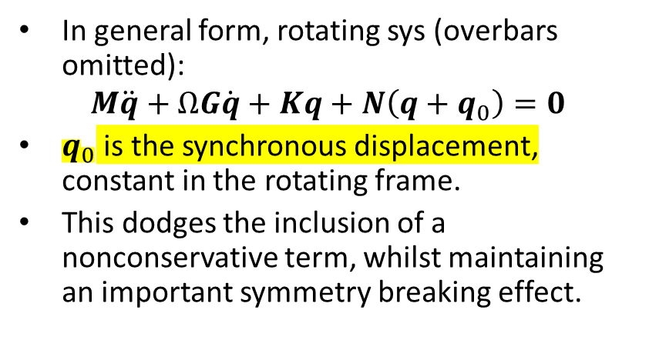
Underlying conservative system
In general form, rotating sys (overbars omitted):
$$M\ddot{q}+ΩG\dot{q}+Kq+N\left(q+q_{0}\right)=0$$
$q_{0}$ is the synchronous displacement, constant in the rotating frame.
This dodges the inclusion of a nonconservative term, whilst maintaining an important symmetry breaking effect.

Slide 21
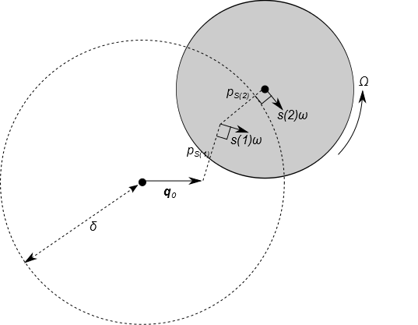
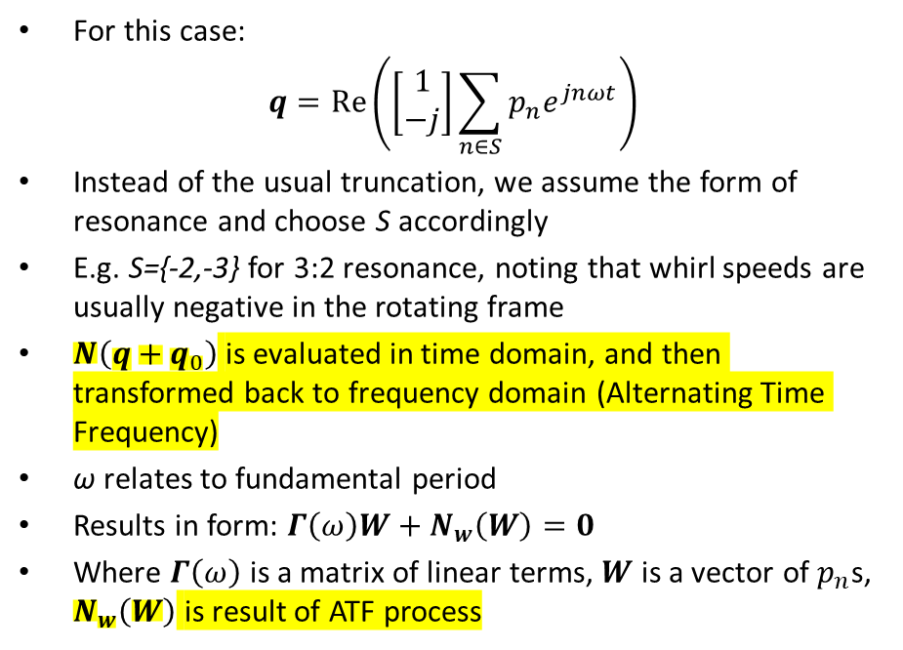
Harmonic balance solution
For this case:
$$q=Re\left(\left[\begin{matrix}1 \\ −j\end{matrix}\right]\sum_{n∈S}{p_{n}e^{jnωt}}\right)$$
Instead of the usual truncation, we assume the form of resonance and choose S accordingly
E.g. S={-2,-3} for 3:2 resonance, noting that whirl speeds are usually negative in the rotating frame
$N\left(q+q_{0}\right)$ is evaluated in time domain, and then transformed back to frequency domain (Alternating Time Frequency)
ω relates to fundamental period
Results in form: $Γ\left(ω\right)W+N_{w}\left(W\right)=0$
Where $Γ\left(ω\right)$ is a matrix of linear terms, $W$ is a vector of $p_{n}$s, $N_{w}\left(W\right)$ is result of ATF process

Slide 22
Solution process
Further assumption –amplitudes are exactly out of phase* hence real
Fix the first amplitude P₁, guess the second P₂
Evaluate ω with quadratic formula
Check residual, use solver to iterate guess for P₂
Then increment the fixed amplitude P₁ and repeat to form the backbone.
(*they’re not really unless near onset)

Slide 23
Backbone at Ω=3.0
Looking for 2:1 resonance, but below drive speed where this is possible
Constant radius whirl orbits, little contribution from backward whirl
Whirl frequency increases but moves away from exact 2:1

Slide 24
Backbone at Ω=3.8
Sudden appearance of fold bifurcations
Strong contributions from backward whirl
Stable solutions (on full system) come from highlighted branch

Slide 25
Pitchfork bifurcation
Project back bone in terms of amplitudes
If synchronous displacement is zero, obtain a perfect pitchfork
Nonzero synchronous displacement breaks symmetry, causes imperfect pitchfork

Slide 26
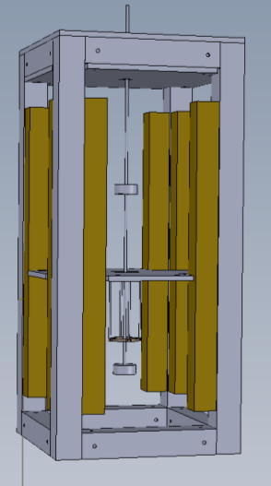
Conclusions and ongoing work
Conclusions:
Asynchronous partial contact orbits are a form of internal resonance in the rotating coordinate system
Many shaft speeds at which this can occur
Hence very rich dynamics of these systems
Conservative system can be extracted, and backbone analysis shows that internal resonance leads to an imperfect pitchfork bifurcation
Ongoing work:
Experimental validation
Further analysis
Impact mapping / grazing bifurcation analysis
MDOF rotors

Slide 27
Thank you
Acknowledgements:
The research leading to these results has received funding from the EPSRC grant ‘Engineering nonlinearity’ EP/G036772/1. We acknowledge useful conversations with Andrea Zilli, Karin Mora and Joachim Sihler.
For more detail see proceedings and:
A. D. Shaw, A. R. Champneys, M. I. Friswell, Asynchronous partial contact motion due to internal resonance in multiple degree-of-freedom rotordynamics, Proc. R. Soc. A 2016 472 20160303; DOI: 10.1098/rspa.2016.0303. Published 31 August 2016

